Slide 1

Performance Evaluation and Applications
POLIMI
A.Y. 2024-2025
Lorenzo Romandini
10939723

Slide 2

Introduction
This presentation introduces the mathematical/statistical formulas used in the assignments given during the lectures to measure the performance indices and workload characterizations that describe the systems examined. Moreover there is the display of graphs and diagrams.
This is a starting point for discussing the codes developed and the topics covered during the course.

Slide 3
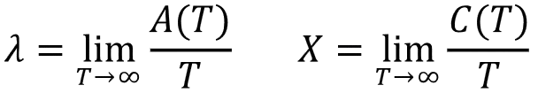
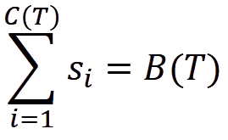
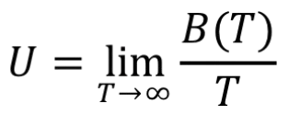
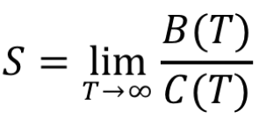
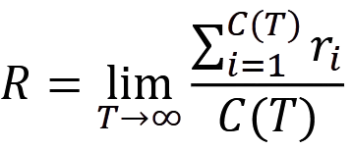
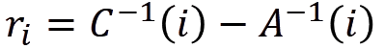
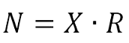
Assignment 01
Basic Performance Indices and Workloads
Arrival rate and Throughput
Service times
Busy time and Utilization
Average Service time
Response times and Average Response time
Little’s Law

Slide 4
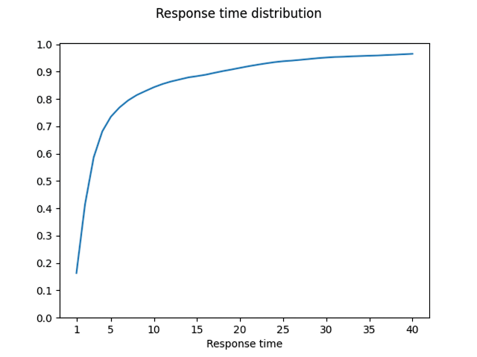
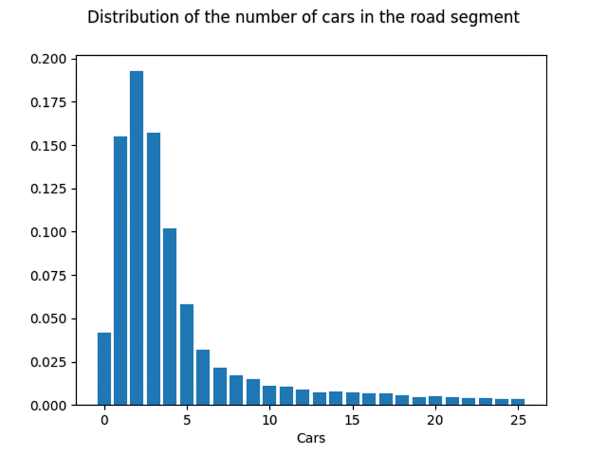
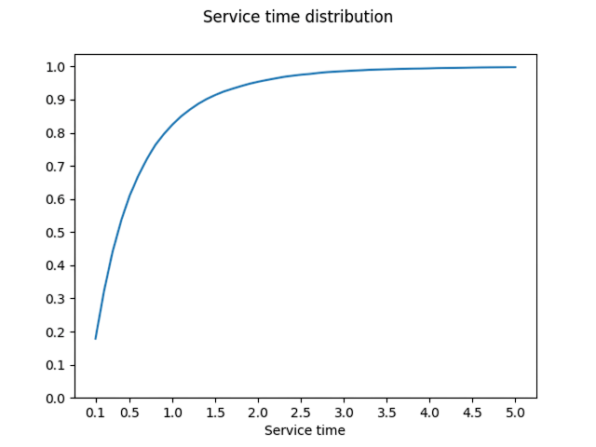
A01 - Plots

Slide 5
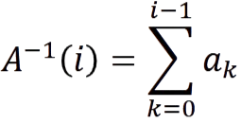
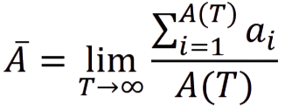
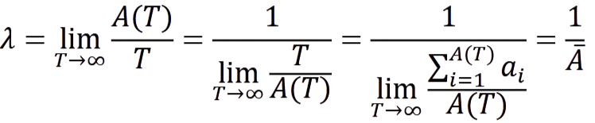
Assignment 02
Basic Performance Evaluation
Arrival times
Completion times
Average inter-arrival time
Arrival rate

Slide 6
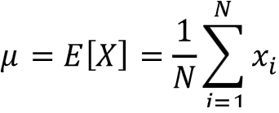
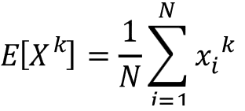
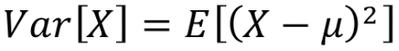
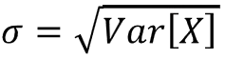
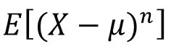
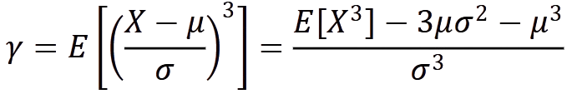
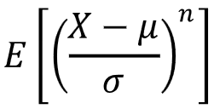
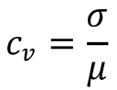
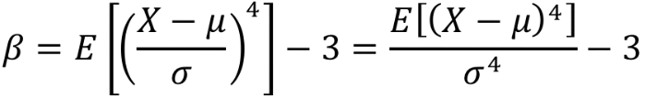
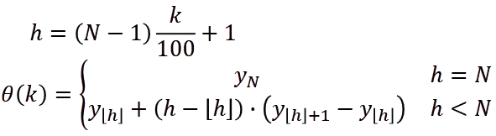
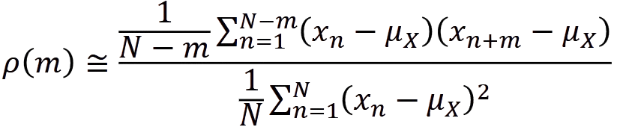
Assignment 03
Workload statistics
Mean and Moments
Variance, Std. Deviation and Central Moments
Skewness and Standardized Moments
Coefficient of Variation and Excess Kurtosis
Median, quartiles and percentiles
Pearson Correlation Coefficient

Slide 7
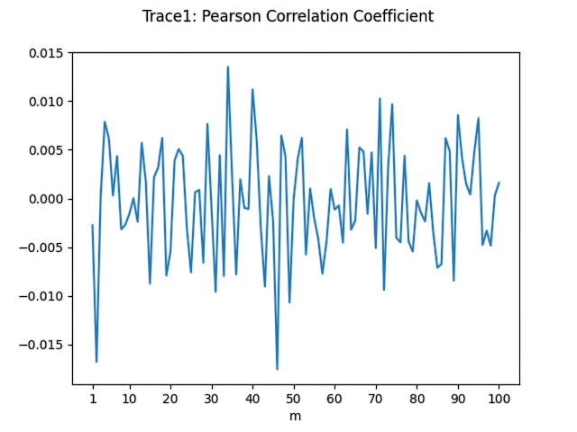
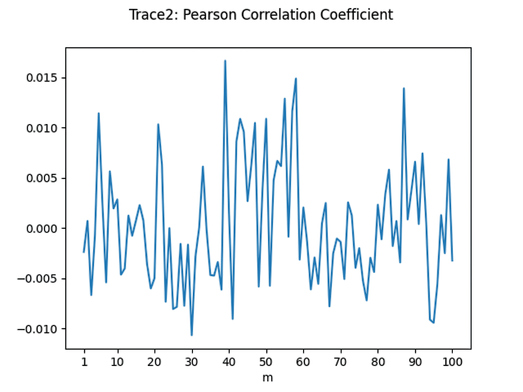
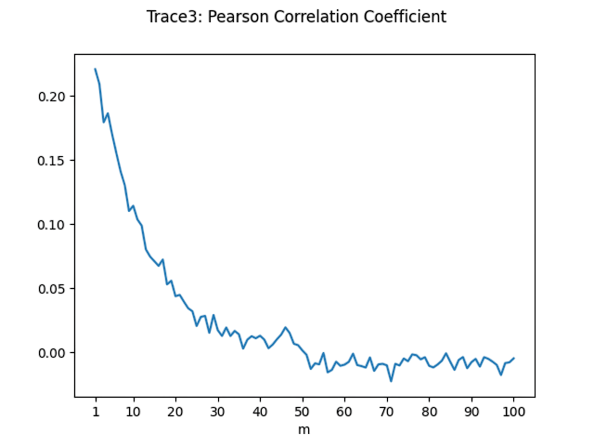
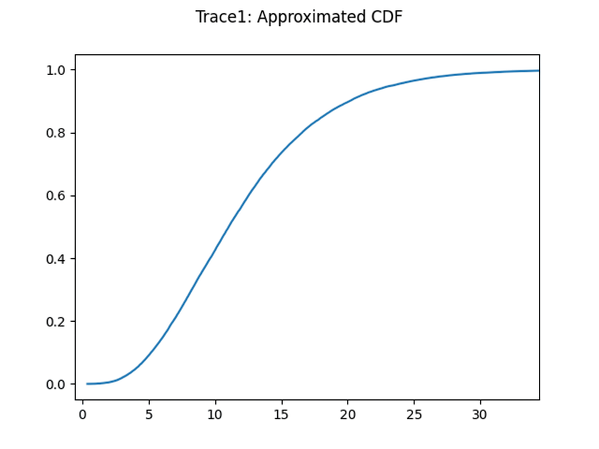
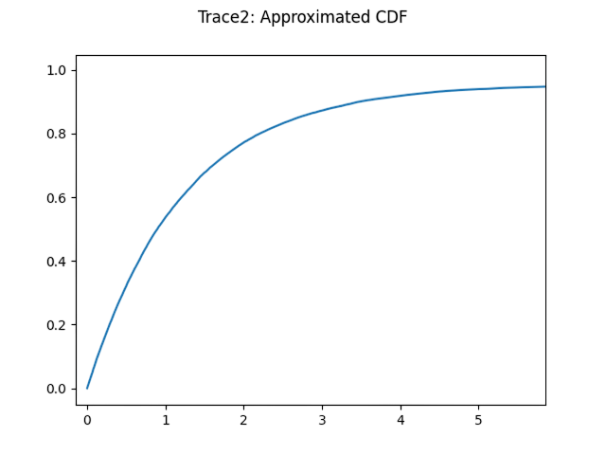
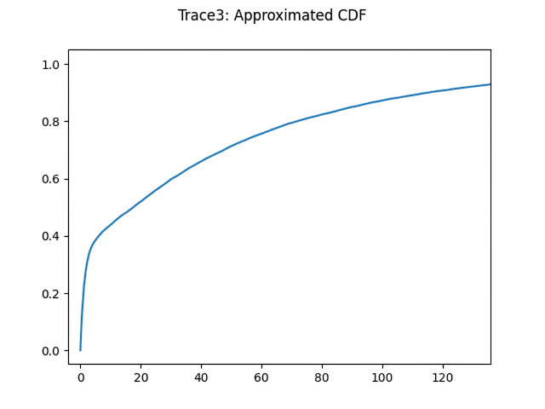
A03 - Plots

Slide 8
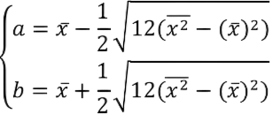
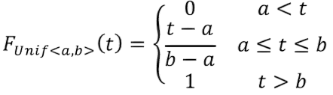
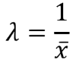
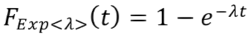
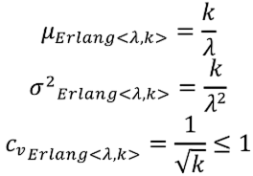
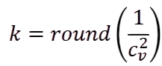
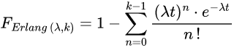
Assignment 04
Fitting – 1/3
Direct expressions
Uniform
Exponential
Erlang

Slide 9
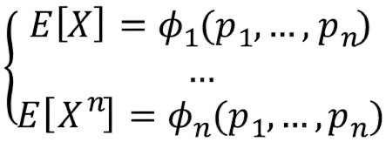
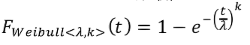
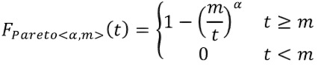
Assignment 04
Fitting – 2/3
Method of Moments
Weibull
Pareto

Slide 10
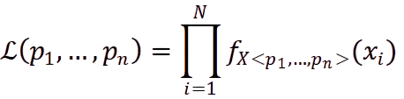
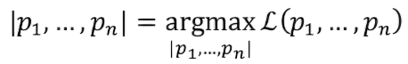
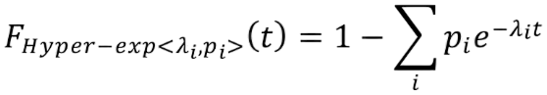
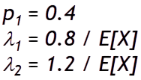
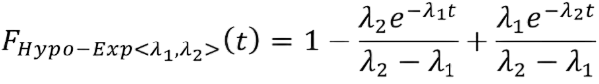
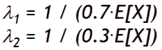
Assignment 04
Fitting – 3/3
Maximum Likelihood
Hyper-Exponential
Hypo-Exponential

Slide 11
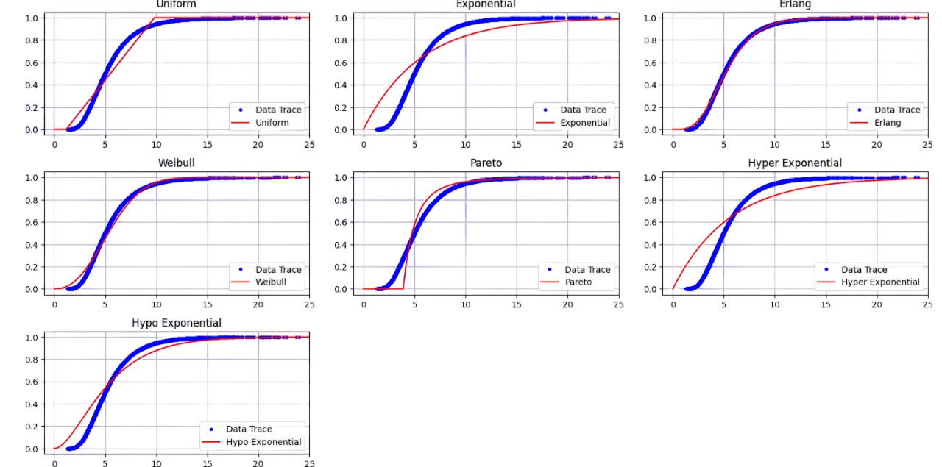
A04 - Plots (Trace 1)

Slide 12
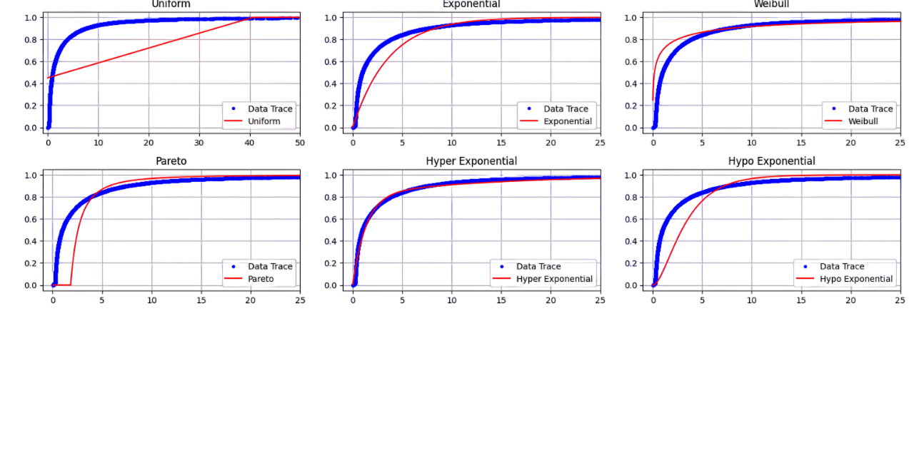
A04 - Plots (Trace 2)

Slide 13
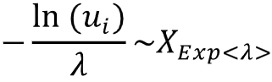
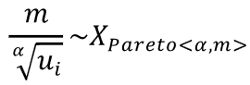




Assignment 05
Random Number Generation
Exponential
Pareto
Erlang
Hypo-Exponential
Hyper-Exponential

Slide 14





A05 - Plots

Slide 15







Assignment 06
Confidence Intervals
Percentile of a standard Normal distribution, with N ≥ 30
Batches
Utilization
Relative Error
Stopping criteria algorithm

Slide 16

Assignment 07
State Machines
State Counter
Time Counter
Current State Time Counter (Probabilistically Computed)
Cycle Counter

Slide 17








Assignment 08
CTMC performance models
Chapman-Kolmogorov equation
Steady-state

Slide 18
























Assignment 09
M/M/c performance models – 1/2
M/M/1
M/M/2

Slide 19












Assignment 09
M/M/c performance models – 2/2
M/M/c
M/M/∞

Slide 20













Assignment 10
M/M/c/K performance models
M/M/1/K
M/M/c/K

Slide 21













Assignment 11
G/G/c performance models
M/G/1
G/G/c
Hyper-Exponential parameters
Standard Deviation and Coefficient of Variation for Arrivals
Average Number of jobs and Approximate Average Response time

Slide 22













Assignment 12
Open models
Arrival rates
Visits
Service Demands and Utilization
Response times and Number of jobs
Delay stations

Slide 23













Assignment 13
Closed models
Visits
Measures
MVA

Slide 24











Assignment 14
Multiclass open models
Visits and Service Demands
Throughput
Utilization
Response times
Number of jobs in the system

Slide 25



Assignment 15
Multiclass mixed models
Visits
Mixed models procedure

Slide 26

Assignment 16
Advanced features
Average Response time
Utilization
Average Number of tasks waiting to enter into the FCR
JSIMgraph model

Slide 27

Conclusion
Statistical analysis and coding are essential for performance evaluation, providing data-driven insights and automation. By combining these tools, we enhance decision-making, optimize efficiency, and apply solutions across various industries. Mastering these skills is key to tackling complex challenges in an increasingly data-driven world. Thank you!
Lorenzo Romandini
Computer Science and Engineering
A.Y. 2024-2025

